Slide 1
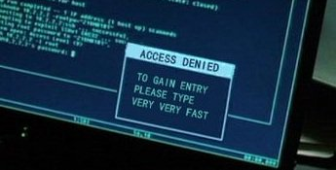
Computer Principles for Programmers
Keyboard Shortcuts in Windows and Visual Studio
Real programmers don’t use the mouse. Neither do actors in movies.
Type like an actor
Notes:
Visual Studio IntelliSense (unlisted) YouTube video at https://youtu.be/bWYNjdLdbZs
Details do not appear when screen sharing during online lecture.
Real programmers and movie/TV actors don't use the mouse. Ever seen an actor do anything at a computer other than flail away at a keyboard? https://tvtropes.org/pmwiki/pmwiki.php/Main/RapidFireTyping
http://geektyper.com/unsc/ [use Backspace key to select other styles]
https://hackertyper.net/
https://geekprank.com/hacker/
http://thepierealm.coffeecup.com/hackerTyper/
https://userinterfaces.aalto.fi/how-we-type/ i.e. type any way you want
https://io9.gizmodo.com/the-10-goofiest-computer-hacking-scenes-in-cinema-histo-5643388
See also https://www.nngroup.com/articles/movies-usability-top-10-bloopers/
Google: using computers in movies –and– actors typing keyboards in movies

Slide 2
News of the Week – readable slide
ICT NEWS
CBC Tech Spark
Globe and Mail Tech
WWW Foundation
Mozilla internet citizen
MIT Tech Review
IT World Canada
IT business
Techmeme
Slashdot
XKCD
Notes:
Google: ict news canada, it news websites
https://webfoundation.org/ The World Wide Web Foundation was established in 2009 by web inventor Sir Tim Berners-Lee to advance the open web as a public good and a basic right.
https://blog.mozilla.org/ We make the internet safer, healthier and faster for good. Mozilla is the not-for-profit behind Firefox, the original alternative browser. We create products and policy to keep the internet in service of people, not profit.
https://www.technologyreview.com/
http://www.itworldcanada.com/
http://www.itworld.com/
http://www.computerweekly.com/
http://www.computerworld.com/
Techmeme - http://www.techmeme.com (aggregator with human editing)
Slashdot - http://slashdot.org/ (aggregator with human editing)
https://www.huffingtonpost.com/section/technology
Ars Technica - http://arstechnica.com/
https://www.theguardian.com/uk/technology
Technowize - https://www.technowize.com/
CNET - http://www.cnet.com/ ( -ZDNethttp://www.zdnet.com/ )
Digital Trends - http://www.digitaltrends.com
Engadget - http://www.engadget.com/
GigaOM - http://gigaom.com/
Gizmodo - http://gizmodo.com/
Mashable - http://mashable.com/
ReadWrite - http://www.readwrite.com
The Next Web - http://thenextweb.com/
The Verge - http://www.theverge.com/
TechCrunch - http://techcrunch.com/
TechRadar - http://www.techradar.com/

Slide 3
News of the Week – unreadable slide
Google: ICT NEWS
https://www.quora.com/What-are-the-best-sources-for-tech-news
http://www.itworldcanada.com/
http://www.itworld.com/
http://www.computerweekly.com/
http://www.computerworld.com/
https://blog.mozilla.org/internetcitizen/
http://www.wired.com/
News Aggregators
Techmeme - http://www.techmeme.com (with human editing)
Slashdot - http://slashdot.org/ (with human editing)
YC Hacker News - http://news.ycombinator.com (with voting)
Hacker News - http://hackernews.org/ (rss feeds)
News Sources
CBC Tech Spark Globe and Mail Tech
WWW Foundation Mozilla internet citizen
MIT Tech Review
Ars Technica - http://arstechnica.com/
CNET - http://www.cnet.com/ ZDNet - http://www.zdnet.com/
Digital Trends - http://www.digitaltrends.com
Engadget - http://www.engadget.com/
Guardian – International USA
GigaOM - http://gigaom.com/
Gizmodo - http://gizmodo.com/
HuffPost - https://www.huffingtonpost.com/...
Mashable - http://mashable.com/
ReadWrite - http://www.readwrite.com
The Next Web - http://thenextweb.com/
The Verge - http://www.theverge.com/
TechCrunch - http://techcrunch.com/
TechRadar - http://www.techradar.com/
Technowize - https://www.technowize.com/
Notes:
Google: ict news canada, it news websites
https://webfoundation.org/ The World Wide Web Foundation was established in 2009 by web inventor Sir Tim Berners-Lee to advance the open web as a public good and a basic right.
https://blog.mozilla.org/ We make the internet safer, healthier and faster for good. Mozilla is the not-for-profit behind Firefox, the original alternative browser. We create products and policy to keep the internet in service of people, not profit.

Slide 4
Talk all you want, don’t write anything down …including the digital equivalents.
When doing activities, labs, workshops, and assignments:

Slide 5
Keyboard Shortcuts Agenda
Lecture and Activity:
Mice are good for users and cats.
All you should need on a web form is TAB & ENTER.
Essential keyboard shortcuts on Windows.
Keyboard shortcuts within Visual Studio IDE.
Using File Explorer
Notes:
Why keyboard shortcuts? Because you create documents and source code by typing. At a keyboard. Why leave the keyboard to find a mouse, find the cursor and so on, when you could do the same things with keyboard shortcuts?
Web forms: you may need the mouse for initial positioning if the programmer has not done that for you. Good web forms do not require the user to employ a mouse.
Week 1 package has a Visual Studio self-guided introduction if you missed it last week.

Slide 6
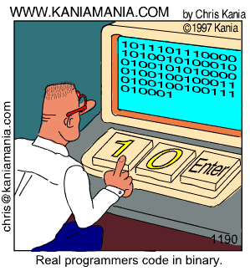
First Computer Keyboard
Notes:
http://9gag.com/gag/133978/

Slide 7

Windows System Shortcuts
Notes:
The magic Windows key… Look! Microsoft has a special key only for Windows PCs. So, please don't buy an Apple computer.

Slide 8
Snapping Windows - Side by Side
 + ← → snap half screen
  to select app on other ½
Hold  + ←↑↓→ snaps to quadrants or other screens
 + ↑ maximize window
 + ↓ restore from max or minimize window
Notes:
Testtesttesttesttest again
Testing
testing

Slide 9
Windows System Shortcuts
 Windows key: start typing to find anything  + Tab: display all active applications Alt + Tab: switch to previously active application Ctrl +Tab: switch between tabs within application Alt + F4: Close program. Ctrl + F4: Close tab.
 + L: Lock PC or switch account. (n/a in Seneca Labs)
 + E: Open File Explorer.  + \  + .  + ..
 + R: Open Run dialog box to start an application
 + D: Show/hide Desktop.
Notes:
Alt + spacebar, C is easy to input from the home row and closes a program like Alt + F4
Windows key symbol in "HoloLens MDL 2 Assets" font. This contains, no only the Windows key, but other useful system symbols.

Slide 10
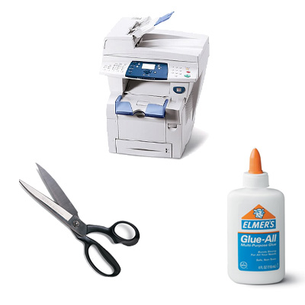

Essential Keyboard Shortcuts in Windows
Notes:
in kindergarten class, you learned to cut and paste and trace (copy). The keyboard metaphors are not an accident.
Windows took Ctrl+X,C,V from the Lisa and Mac projects at Apple who took it from Xerox PARC (Palo Alto Research Center) founded in 1970.
There are other shortcut keys which we will get to in the activity section.
http://www.digitaltrends.com/computing/cut-copy-paste-beginners-guide/
http://www.howtogeek.com/115664/42-text-editing-keyboard-shortcuts-that-work-almost-everywhere/
https://support.microsoft.com/en-ca/help/12445/windows-keyboard-shortcuts
http://www.hongkiat.com/blog/100-keyboard-shortcuts-windows/

Slide 11
Windows Editing Shortcuts
Ctrl + Z / X / C / V / Y to undo, cut, copy, paste, redo
 + V to paste from clipboard history. Pin to keep!
Ctrl + F is for find
Ctrl + H to find and replace text (be careful)
Ctrl + S saves the file (save early, save often)
or use Autosave
Notes:
"Important: If you're not using AutoSave or if your file is not stored on OneDrive or SharePoint, the Save button is still your best friend. To be sure you don’t lose your latest work, select Save (or press Ctrl+S) often."
https://support.office.com/en-us/article/help-protect-your-files-in-case-of-a-crash-551c29b1-6a4b-4415-a3ff-a80415b92f99

Slide 12
Navigation Shortcuts in Windows
Home: go to start of line. CTRL+Home: top of document
End: go to end of line. CTRL+End: bottom of document
SHIFT+Home/End selects from cursor position to start/end
Alt+Shift+Up/Down: Moves the paragraph up/down. Or, select any portion of multiple paragraphs and move all.

Slide 13
Navigation Shortcuts in Windows
CTRL + Right → go forward one word
CTRL + Left ← go backward one word
CTRL + Up ↑ go to previous paragraph
CTRL + Down ↓ go to next paragraph
CTRL + A selects ALL
SHIFT + ←↑↓→ selects char, + Ctrl selects word
Notes:
CTRL + Up / Down will scroll window pane contents up / down one row/line at a time. It is similar to page down which moves a pane's worth of lines up / down.

Slide 14
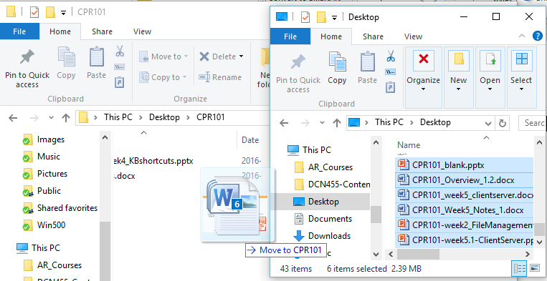
File Explorer – Move or Copy ?
Be careful with drag & drop
dragging with Left button to
the same drive moves files
a different drive copies files
Click & drag with Right mouse button to get options for dropping

Slide 15
Visual Studio IDE
Notes:
VS IDE, Help menu / Keyboard Accessibility ( ALT+H K )
https://docs.microsoft.com/en-ca/visualstudio/ide/reference/how-to-use-the-keyboard-exclusively

Slide 16
Visual Studio IDE
To develop an application, edit your source code, save the source file in an organized place, compile/build the program, and run/debug your program.
An industrial strength IDE like VS does all these steps in an integrated development environment, instead of doing each step with different software/shell and switching among those.
… letting you concentrate on your development job.
Notes:
IDE = Integrated Development Environment

Slide 17
Visual Studio IDE
Developers work inside IDEs like VS most of the time.
Keyboard shortcuts save time and facilitate your job there.
Keyboard shortcuts are vital to productivity.
Other development advantages with an IDE like VS: create games, web, mobile, and cloud based apps, connect to databases, team services and collaboration, version control, package and release management, repositories, Git support, and more.

Slide 18

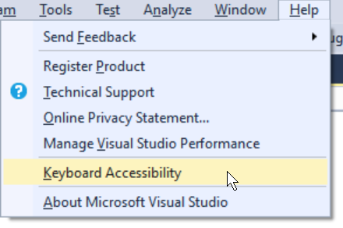
Useful Keyboard Shortcuts in VS IDE
Windows selection & editing shortcuts work in Visual Studio
Notes:
VS IDE, Help menu / Keyboard Accessibility ( ALT+H K )
https://docs.microsoft.com/en-ca/visualstudio/ide/reference/how-to-use-the-keyboard-exclusively

Slide 19
Keyboard Shortcuts in VS IDE
Ctrl + KD formats source code
F7 or Ctrl + Shift + B builds your application
Ctrl + F5 runs it
Alt + Up ↑ moves current / selected lines up Alt + Down ↓ moves current / selected lines down
Ctrl+KC Comments current / selected lines Ctrl+KU Uncomments current / selected lines

Slide 20
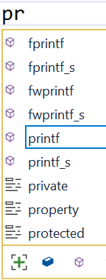
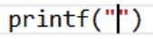
Visual Studio IntelliSense
Code and variable name completion
Start typing + TAB to complete
type ( and its completing pair ) is inserted; same with " Ctrl + Spacebar turns on IntelliSense
before you start typing or, when it is staying out of your way, to turn it back on.
See demo on next slide
Notes:
* IntelliSense assists programming by offering automatic code and syntax completion.
* IntelliSense is sensitive to the source file extension, e.g. _____.c for C language source files. Only items relevant to that source file language are displayed.
* IntelliSense is activated when you begin to type a command, function, or variable name, e.g. "pr" to print. A list appears with items matching the characters typed.
* Pressing TAB selects the default item and completes your partially typed code. Use Up/Down to select a different item in the IntelliSense list and press TAB or Enter to insert that item.
* Ctrl + Spacebar turns on IntelliSense before you start typing or when it is staying out of your way
* Key ( for a left parenthesis, and the right hand ) is automatically inserted with the cursor positioned between them; for a function like printf, the comments and parameters are shown.
* Key " to open a quoted string of characters and IntelliSense automatically inserts a matching double-quote "; the cursor is positioned inside the quotes ready for the entry of a text string. This works for any matched pair of punctuation marks: ( ) { } [ ] " " ' ' /* */

Slide 21
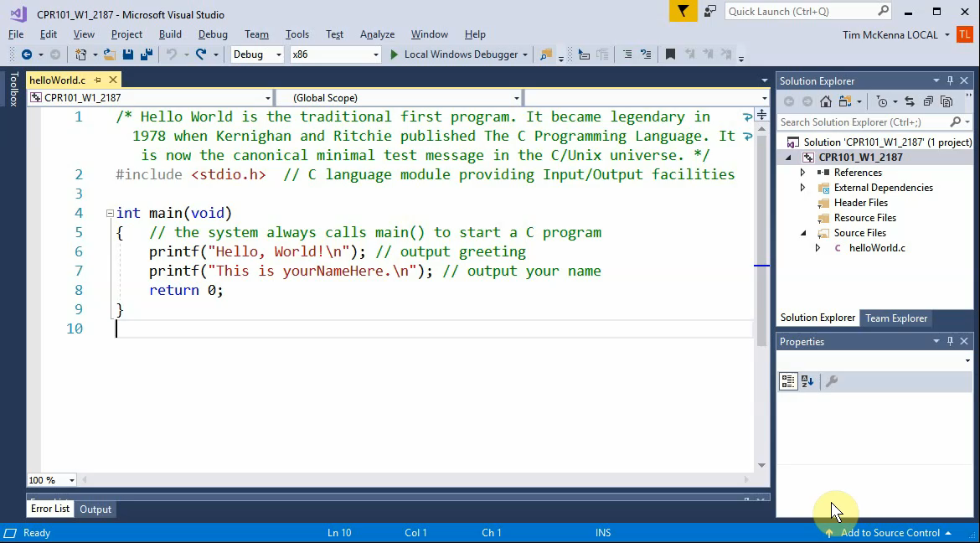
For animation, hover mouse cursor over image and click PLAY  triangle in bottom left
➔
Notes:
Unlisted YouTube video at
https://youtu.be/bWYNjdLdbZs
Details do not appear when screen sharing during online lecture.

Slide 22
Today's activity: practice using the keyboard instead of the mouse
More keyboard shortcuts and using File Explorer follow in the notes below for your self-study and reference.
Quiz questions are taken from the slides above and from concepts and exercises in the week's activity.

Slide 23
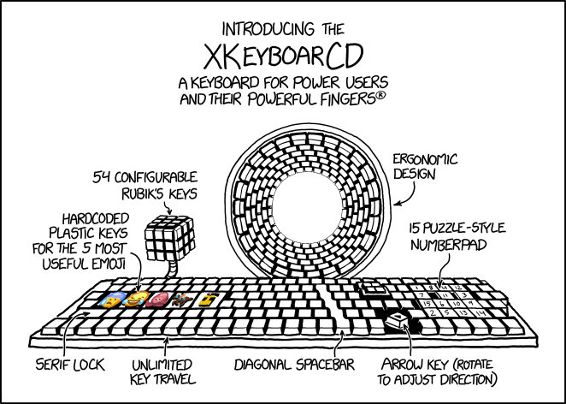
Notes:
https://imgs.xkcd.com/comics/xkeyboarcd.png
The key caps use LCD displays for all the vowels, so they can automatically adjust over the years to reflect ongoing vowel shifts while allowing you to keep typing phonetically.

Slide 24
Essential Keyboard Shortcuts in Windows
CTRL + A: Selects all items (files or text) in the folder/document.
CTRL + C: Copies selected items to the clipboard (temporary storage in memory for pasting, replaces previous clipboard)
CTRL + X: Cuts the selected items to the clipboard.
CTRL + V: Pastes from clipboard to folder/document.
CTRL + Z: Undoes the previous action.
CTRL + Y: Redoes the previous action.
CTRL + D: Sends the selected item to Recycle Bin Shift + D permanently deletes the item, bypassing the Recycle Bin.

Slide 25
Helpful Windows Key Shortcuts (cont’d)
CTRL + F1: Closes/Opens the ribbon in the active window.
 (Windows Key)  : Opens/closes Start Menu which is searchable…just start keying what you are looking for
 + Home: minimizes / restores all but the active window.
 + Up Arrow: maximize active window
 + Down Arrow: restore active window size (from max) or minimize
 + Shift + Up Arrow: Stretches active window to maximum vertical size

Slide 26
Windows System Shortcuts
Alt + Esc, Alt + Shift + Esc cycles through open windows in sequence used
CTRL + Shift + Esc opens Windows Task Manager
ALT + Enter shows properties of selected file or folder
You can find a more complete list of Windows Keyboard Shortcuts in the attached PDF files to this lecture and/or online. With practice, you'll learn to use them. Some people like to print the PDFs and keep beside screen or keyboard as a handy reference.

Slide 27
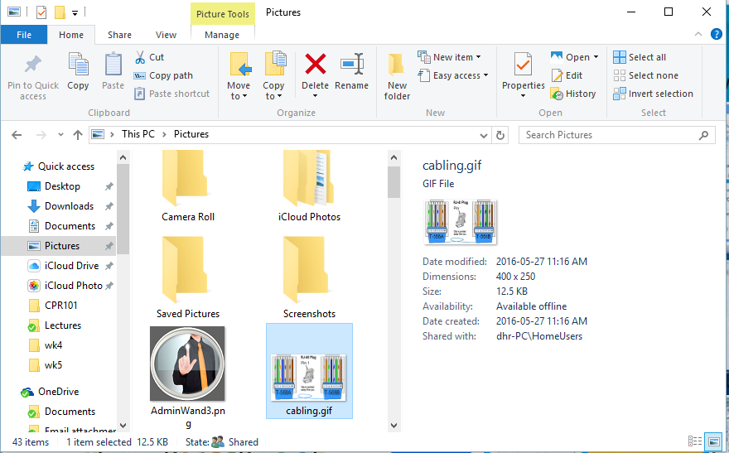
File Explorer
Notes:
Most of the same Windows select, copy, cut, paste shortcuts work in File Explorer

Slide 28
File Explorer Terminology
Quick Access Toolbar
Ribbon
Menu Bar
Address Bar
Navigation Pane
Content Pane
Preview Pane

Slide 29
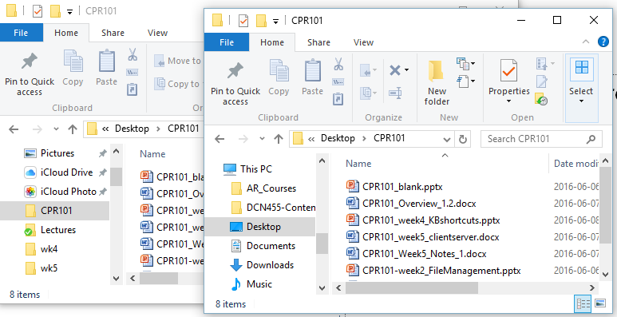
File Explorer – Opening New Window in Same Folder
CTRL + N does so. (CTRL + SHIFT + N creates a new sub folder)
Handy when dragging and dropping or copying files.
Just change path, to destination folder, in the second window.

Slide 30

File Explorer – Moving and Copying Using Mouse

Slide 31
File Explorer – Moving and Copying Using Mouse
Be careful with drag & drop
Dragging files to
the same drive moves files
a different drive copies files
hold CTRL to copy or
Click & drag with Right mouse button

Slide 32
File Explorer – Moving and Copying Using Mouse (Cont’d)
When dragging files to a different drive, the default behavior is to copy the files, not to move.
During dragging, press the SHIFT key to move the files. Release the SHIFT after the drop operation.

Slide 33
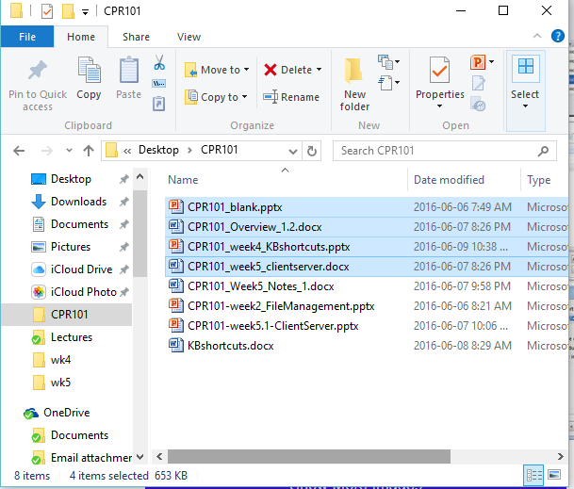
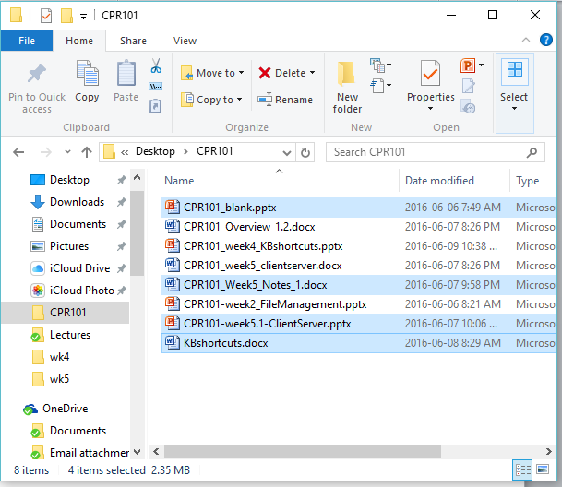
File Explorer – Selecting Files
To copy a group of files, click the first one.
Hold the SHIFT key.
Click the last file.
To select individual files, hold the CTRL Key.
SHIFT
CTRL

Slide 34
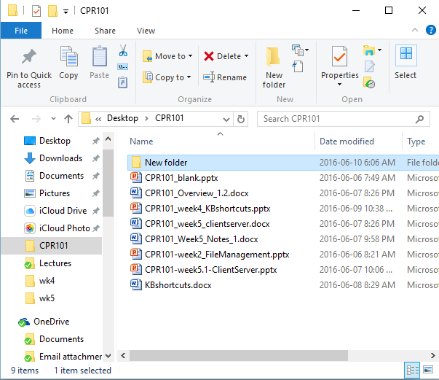
File Explorer – Renaming Selected Item, Opening Search, and Refreshing Current Window
F2 is used for renaming.
F3 is used for searching for a file or folder in the active window.
F5 is used for refreshing the current window.

Slide 35
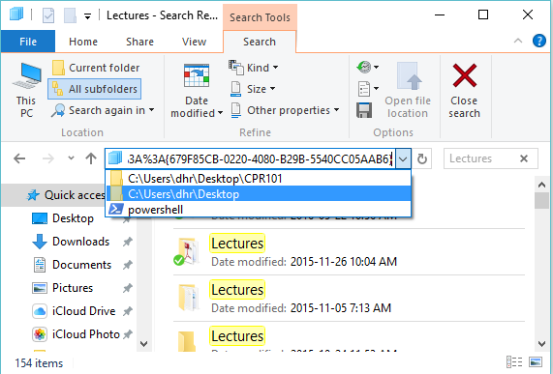
File Explorer – Opening Address Bar, and Cycling Through Window Elements
F4 is used for displaying the address bar history.
F6 is used for cycling through Window Elements.
Test F6 when you have selected a file. Get in the habit of adding a Tag/Category to the file header. It would be ideal for general search criteria.

Slide 36
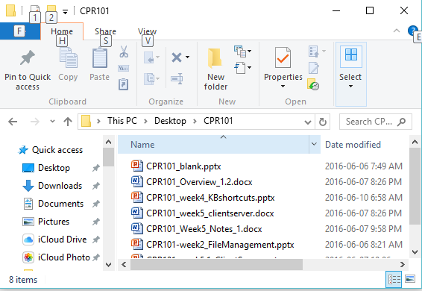
File Explorer – Activating the Menu Bar
F10 does so.
Press the letter shown to select the menu items and sub items.
You could also use ALT + letter to access the menu item from the beginning.

Slide 37
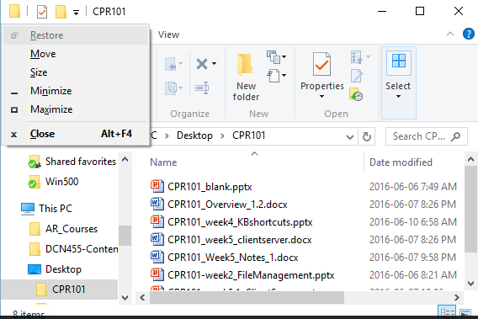
File Explorer – Opening the Short Cut Menu, and Closing Current Window
ALT + Spacebar does this for you.
You could then choose the menu selection letter if you want.
You could also use CTRL + W or ALT + F4 to close current window.

Slide 38
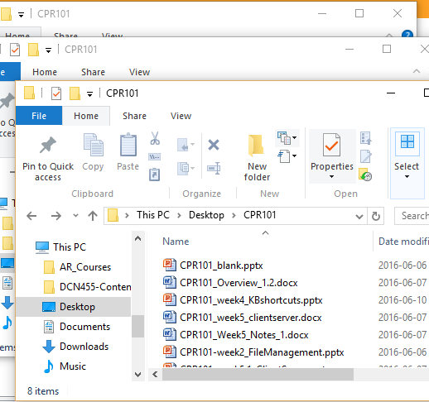
File Explorer – navigates like browser
Browser window navigation
ALT + ← go back to previous folder
ALT + → go forward to next folder
F11 toggles full screen mode

